Slide 1
CSTN Final Presentation
Pod 5: Jack Gordon, Kyle Walker, Hannah Babin Stiene

Slide 2
Agenda
Problem Definition
Our Solution (FreshService)
Evaluation Criteria
Implementation Plan
Help Desk Model/Procedures
Workflow and Escalation
Budget
Milestones
Timelines
Risks & Contingencies
Sustainability
Conclusion
Q&A

Slide 3
Problem Definition
Fragmented support
Delayed ticket resolution
Lack of automation and reporting
Poor visibility for end users

Slide 4

FreshService
FreshService selected after weighted evaluation
Cost-effective and scalable
Automates ticket triage and escalation
Includes built-in asset tracking and knowledge base

Slide 5
Evaluation Criteria
Organization: How well are the tickets organized? How user friendly is the UI? Sorting tools? Customization?
Management: Are tickets easy for users to create? Are they assigned to the correct technician?
Automation: Is the user and agent notified of changes to the ticket automatically? Are workflows implemented for users to solve simple issues themselves like password resets? Are tickets automatically distributed based on severity?
KBA: Is a KBA inserted into the tool? Can end-users follow a flowchart/workflow to troubleshoot the issue themselves before a ticket is generated?
Pricing: How expensive is the license? Is there a trial version? Are there levels to their license?
 | Organization (15%) | Management (20%) | Automation (30%) | KBA (10%) | Pricing (25%) | Weighted Score (0-10)
Zendesk | 10 | 8 | 10 | 10 | 3 | 7.85
FreshService | 9 | 9 | 10 | 8 | 7 | 8.7

Slide 6

Implementation Plan
Planning (Weeks 1–2)
Deployment & Integration (Weeks 3–4)
Go-Live & Optimization (Weeks 5–6)

Slide 7
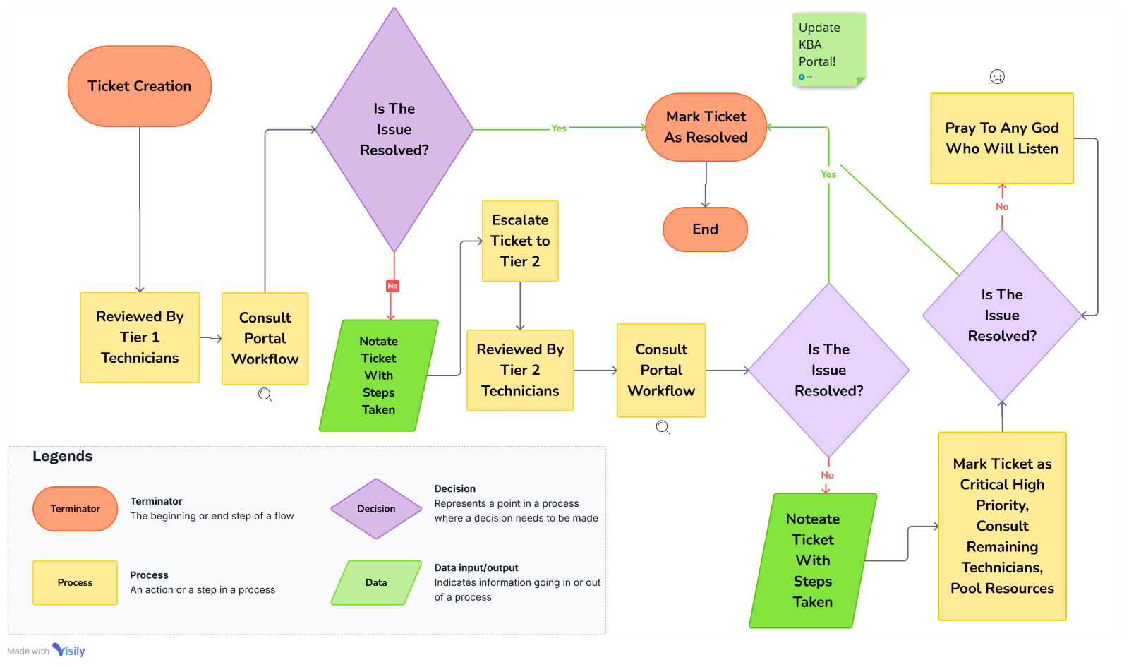
Help Desk Workflow and Procedures
Incoming tickets are auto-triaged based on keywords, severity, and request type
SLAs: Low Priority: 48-hour response Medium: 24 hours High: 8 hours or less
Tickets unresolved within SLA auto-escalate.

Slide 8
Budgeting
Hardware
Three Workstations - $4500
Nine Monitors - $2250
Peripheral Devices - $5000
Backup Power Supplies -
Software (Zendesk, Microsoft 365, AnyDesk, SolarWinds)
Desk and Chairs - $8000
Staffing
One Level 2 Technician paid $60,000/yr
Two Level 1 Technicians paid at $42,500/yr
Contingency Fund $10,000

Slide 9

Budgeting (cont')
Licensing (Pro Plan): $3,540
Hardware: $6,500
Training: $1,500
Total Year 1 Cost: ~$11,540

Slide 10
Proposal Milestones
Phase 1 (1 Month): Planning and Design
Finalizing Software, Hardware, and Confirm Budget
Phase 2 (1 Month): Hardware Installation and setup
Setting up workstations for staff
Phase 3 (2 Months): Software implementation/imaging and Networking
Installing/imaging Help Desk software, configuration of network
Phase 4 (2 Month): Staffing and training
Hiring and training staff in how to use software, tools, etc.
Phase 5 (1 Month): Testing and Execution
Testing workstations and software.

Slide 11
Timelines
Phase | Task | Projected Completion Date
Planning | Finalizing the budgets for the hardware, software, and determining what is needed. | Feb 15
Hardware Setup | Install and configure workstations | Feb 21, 2025
Software Installations | Release the Ticketing System and any Security Software | Mar 1, 2025
Staffing | Hire helpdesk technicians | Mar 14, 2025
Training | Protocol training for helpdesk | Mar 21, 2025
Go-Live and Testing | Final system testing and deployment! | Mar 31, 2025
General Upkeep | Ongoing support for 1 year regarding the setup of the help desk. | Mar, 2026
Additional Considerations
Accessibility: Help Desk Portal will support screen readers
Disaster Recovery: FreshService data is cloud-based with built in redundancy
Feedback Integration: Real-time user ratings per ticket resolution

Slide 12

Risks & Contingencies
Risk: Cost overruns from subscription tiers
Mitigation: Annual review and user audit
Risk: Staff resistance to change
Mitigation: Ongoing training & Support

Slide 13
Sustainability Plan
Monthly training refreshers
Annual cost reviews
Feedback loops via ticket ratings
Flexible licensing tiers

Slide 14
Conclusion
We've selected and designed a scalable, cost-effective Help Desk system using FreshService! (But actually we are using SpiceWorks!)

Slide 15

Questions?

Slide 16

Thank you!
Credits:
Person #1: Kyle Walker
Person #2: Hannah Babin Stiene
Person #3: Jack Gordon

